Slide 1
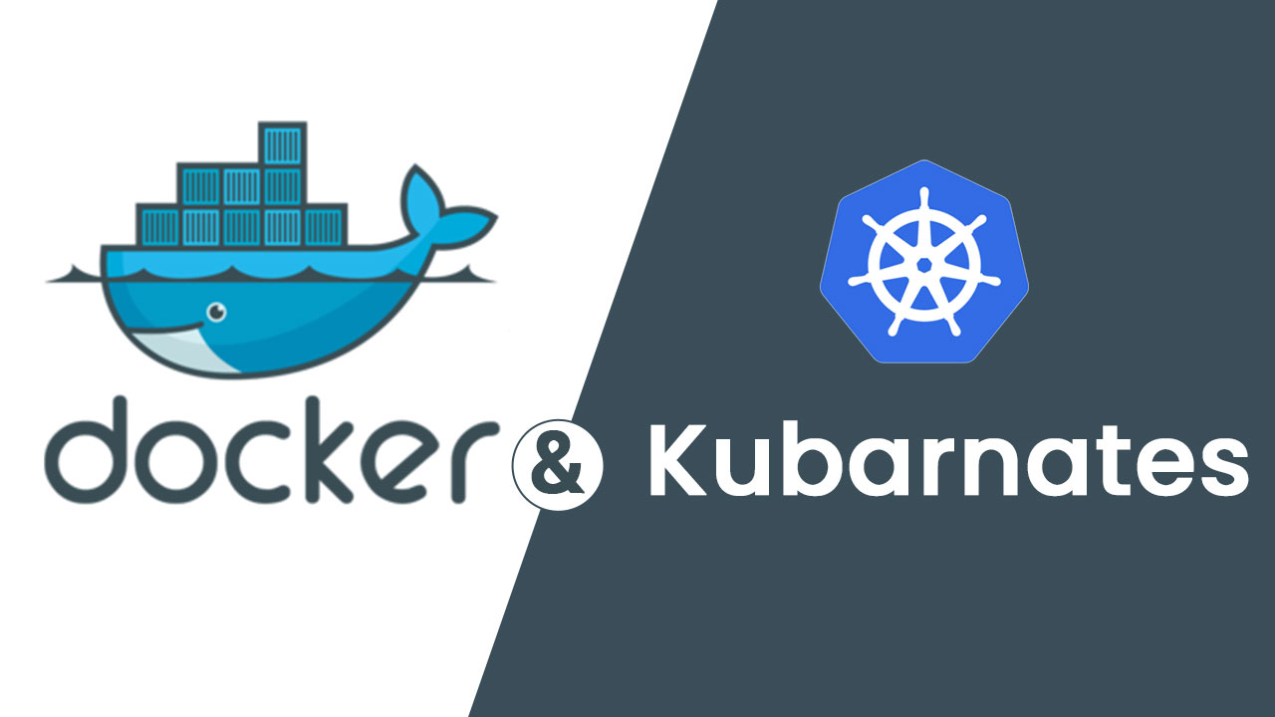
Murali Mohan

Slide 2
Why do we want learn docker & k8’s
To get high salaries
To become expert in devops
You want be certified professional
What you want be

Slide 3
Trainer introduction
NAME : Murali MOHAN
Experience : 7+
Current organization : beep beep beep
Training experience : 4+ , delivered 25+ batches and also experience in corporate training
Clients : raxicube technologies , mindtree,eclytics,tutorzworld,itonlinehub,Technoedge

Slide 4
agenda
WHAt is docker
Docker container vs virtual machine
Images and containers
Docker use cases
Dockerfile
What is kuberneters & architecture
How to create a cluste in gke
How to deploy an application in kubernetes cluster a

Slide 5
Docker introduction

Slide 6
what is docker:
Docker is an open-source project that automates the deployment of application inside software containers
by providing a layer of abstraction and automation of operating system-level virtulization on linux. It allows
developers and system administrators to build,ship and run distributed applications.
It can run on linux distribution , Windows and Mac OS.
It is supported by most of cloud provides.

Slide 7

what is docker:
Docker is an open-source project that automates the deployment of application inside software containers
by providing a layer of abstraction and automation of operating system-level virtulization on linux. It allows
developers and system administrators to build,ship and run distributed applications.
It can run on linux distribution , Windows and Mac OS.
It is supported by most of cloud provides.

